Slide 1
Agile Project Management Software
March 2023
High-Level Design Document
Open Source Software with MIT License

Slide 2
Agenda
Agile Project Management Software
Introduction
Overall Theme
Why this software?
What this software will do?
How this software can be utilized?
Who can be benefited from this software?

Slide 3
Agile Project Management Software
There are many software to manage projects, and in this category we are going to create a open-source software that utilizes agile mindset approach in managing the projects.
This project overview itself is a concept of agile project management software and will utilize this approach in the future as a self-hosting software application.

Slide 4
Introduction
Agile Project Management software primary focus is to provide the agile mindset as the foundation for managing projects, by this approach, the users and organization can utilize a customized or standard approach that is applicable for their context.
For example, if an organization is utilizing a Scrum approach or Kanban approach or Scrum+Kanban+XP approach, they can utilize the software to customize their workflow and theme, and also they can utilize Agile @ Scale approach that can work with their entire organization.

Slide 5
Overall Theme
Agile mindset fundamentally based on Value, Principles and Practices.
Agile practices are based on roles, ceremonies and artifacts. We could add measurement and metrics along with the business context to make this applicable to commercial or open-source projects.

Slide 6
Why this APM Software?
Agile Project Management Software is a way to introduce the agile mindset into the organization by creating a powerful habit of utilizing the practices on a daily basis and create a single-source of truth.

Slide 7
What this APM Software will do?
Agile Project Management Software will primarily address the transparency, inspect & adapt theme for better visibility of the progress of the value delivery.
Visualization
Workflow
Users with Roles
Ceremonies
Multiple Projects, Program, Portfolio, Organization structure management

Slide 8
How this APM Software can be utilized?
This Agile Project Management software can be utilized by installing on the Organization computer and as a web service or can be hosted on a public domain and accessed via intranet / internet.
Create organization, units, users and corresponding implementation level details in the software for project management.

Slide 9
Who can be benefited from this software?
Organization that want to create a custom agile mindset implementation or practice a specific agile framework in a customized way, can benefit from this software.

Slide 10
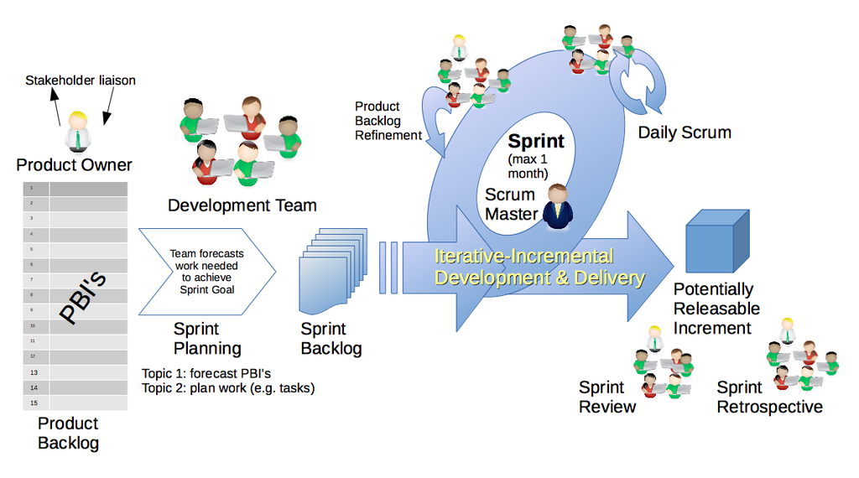
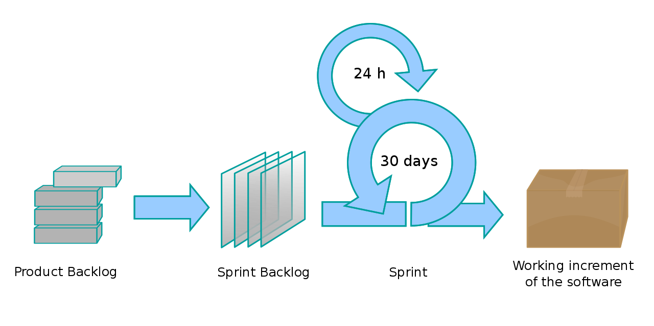
Agile/Scrum approach
Initial Version to start with Agile/Scrum and then add other agile flavors like Kanban and
Customization of combining approaches.

